Slide 1
SOFT152: Software Engineering
Double Buffering
Please see the DoubleBufferingProject.zip

Slide 2
Double-Buffering
When updating a displaying graphics and a moderate or fast interval (e.g. when using a timer to generate drawing events), the resulatant image can appear to flicker.
A standard technique to alleviate this is to use a technique known as Double-buffering.
It is fairly straightforward to implement.
In short, the technique involves these steps:
Create a Bitmap to draw on
Obtain the graphics context of that Bitmap image
Draw on the image as per usual
When finished, draw the Bitmap image on a Panel
The code for these steps are shown in the next few overheads

Slide 3
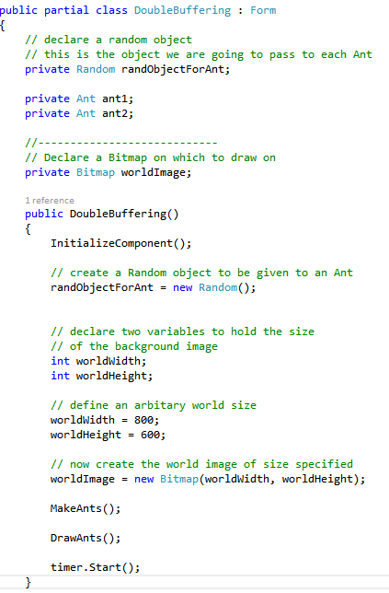
This is the Bitmap to be drawn on
In the constructor of the Form:
1. Define a width and height for the Bitmap.
2. Then create the Bitmap itself

Slide 4
Having declared and created a Bitmap, the next step is to actually draw on the image.
Then display that image on the panel
Only real change is we need to get the graphics context of the image, so we can use that graphics to draw with
All the drawing methods are the same as before, except drawing is done with the graphics of the Bitmap
Last step is to draw the image on a panel. It is only now it is visible to the user

Slide 5
Using Random Numbers in Objects
When an object of class Random is created, using code similar to this:
Random randObject;
randObject = new Random();
The randObject needs to have a ‘seed’ which is used to generate a sequence of random numbers.
If no seed value is provided when creating the object, by default the object will use the system clock as a basis.
If several random objects are created in very quick succession, then each will have the same seed value and generate the same pattern of random numbers.

Slide 6
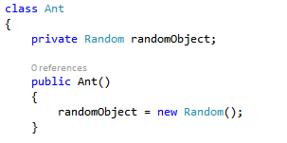
Using Random Numbers in Objects
Typically when giving an Ant a random number, one approach may be to do something like this:
A random object is declared as a field, and is then created in the Ants constructor
With only one Ant this would be fine.
If however there is a List<T> of ants and each ant is created in quick secession (e.g. in a for-loop), then each Ant’s random object will have the same seed and will generate the same sequence of random numbers.

Slide 7
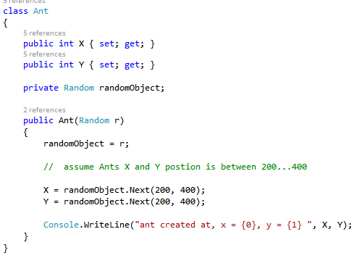
Using Random Numbers in Objects
An approach to overcome this, is to pass in a random object when creating the Ant
A random object is still declared as a field, but is assigned random object passed as a parameter in the constructor
Now can use the random object to randomly assign some (x, y) positions to the Ant

Slide 8
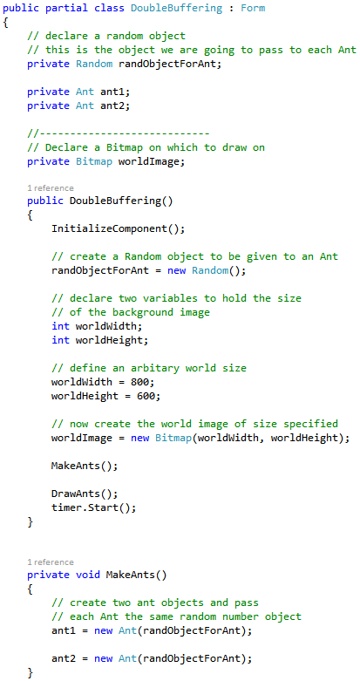
The Ant is passed the random object when it is created in the Form:
Declare a random object for the Ant
Create the random object in the constructor
Now pass the random object as a parameter when creating the Ants.

